Slide 1


Chelsie Amico
09/21/2024

Slide 2

Outline
Executive Summary
Introduction
Methodology
Results
Conclusion

Slide 3
Executive Summary
Summary of Methodologies
Research attempts to identify the factors for a successful rocket landing. To make this determination the following methodologies were used:
Collect data using SpaceX REST API and web scraping techniques
Wrangle data to create success/fail outcome variables
Explore the data with data visualization techniques, considering the factors: payload, launch site, flight number, and yearly trends
Analyze the data with SQL, calculating the following statistics: total payload, payload range for successful launches, and total number of successful and failed outcomes
Explore launch site success rates and proximity to geographical markers
Visualize the launch sites with the most success and successful payload ranges
Build Models to predict landing outcomes using logistic regression, support vector machine (SVM), decision tree, and K nearest neighbor (KNN)
RESULTS
Exploratory Data Analysis:
Launch success has improved over time
KSC LC-39A has the highest success rate out of all the landing sites
Orbits ES-L1, GEO, HEO, and SSO have a 100% success rate
Predictive Analytics:
All models performed similarly on the test set. The decision tree model slightly overperformed
Visualization/Analytics:
Most launch sites are near the equator, and all are close to the coast

Slide 4
Introduction
BACKGROUND
SpaceX, a leader in the space industry, attempts to make space travel affordable to all. Their accomplishments include sending spacecraft to the international space station, launching a satellite constellation that provides internet access and sending manned missions to space. SpaceX can do this because the rocket launches are relatively inexpensive in comparison ($62 million per launch) due to their reusage of the first stage, which can cost up to $162 million each. By determining if the first stage will successfully land, we can determine the price of the launch. To achieve this, we can use public data and machine learning models to predict whether SpaceX – or a competing company- can reuse the first stage.
EXPLORE
How payload mass, launch site, number of flights and orbits affect the first stage and landing success Rate of successful landings over time
Best predictive model for successful landing (binary classification)

Slide 5

Section 1

Slide 6
Methodology
STEPS
Collect data using SpaceX REST API and web scraping techniques
Wrangle Data – by filtering the data, handling missing values, and applying on hot encoding – to prepare the data for analysis and modeling
Explore data via EDA with SQL and data visualization techniques
Visualize the data using Folium and Plotly Dash
Build Models to predict landing outcomes using classification models. Fine tune and evaluate models to find best model and parameters

Slide 7
Data Collection
STEPS
Request data from SpaceX API (rocket launch data)
Decode response using .json() and convert to a dataframe using .json_normalize()
Request information about the launches from SpaceX API using custom functions
Create dictionary from the data
Create dataframe from the dictionary
Filter dataframe to contain only Falcon 9 launches
Replace missing values of Payload Mass with calculated.mean()
Export data to .cvs file

Slide 8
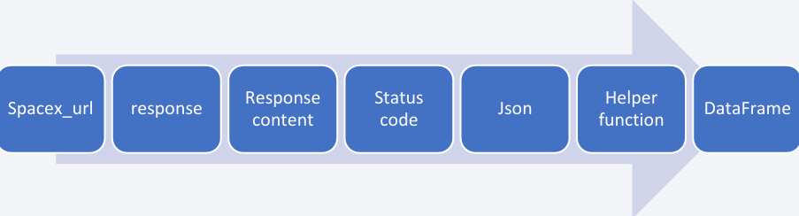
Data Collection – SpaceX API
SpaceX URL, Response, Json, Dataframe
GitHub SpaceX API Notebook

Slide 9
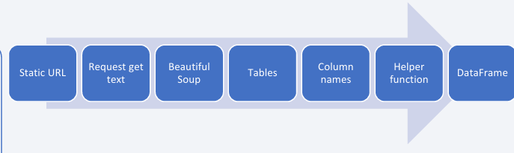
Data Collection - Scraping
Static URL, Beautiful Soup, DataFrame
GitHub URL Web Scraping Notebook

Slide 10
Data Wrangling
The cleaned data was first imported, and I checked what percentage of missing values is in the LaunchingPad since it was the only column still containing null values indicated when “no LaunchingPad” was used. I checked the datatype of each column, there are four different datatypes (int64, object, float64, and bool). Further analysis like value count of LaunchSite was also examined for the various facilities Cape Canaveral Space Launch Complex 40 VAFB SLC 4E seems to have the highest count of 55.
I created a new feature called “Class” from the outcome’s column were all outcomes containing the name “False” and “None” are regarded as bad; therefore, a binary of zero was assigned for bad outcomes, and one was assigned for good outcomes.
I also calculated the success rate of all the good outcomes which make up 66.67% of the class feature.
GitHub Data Wrangling Notebook

Slide 11
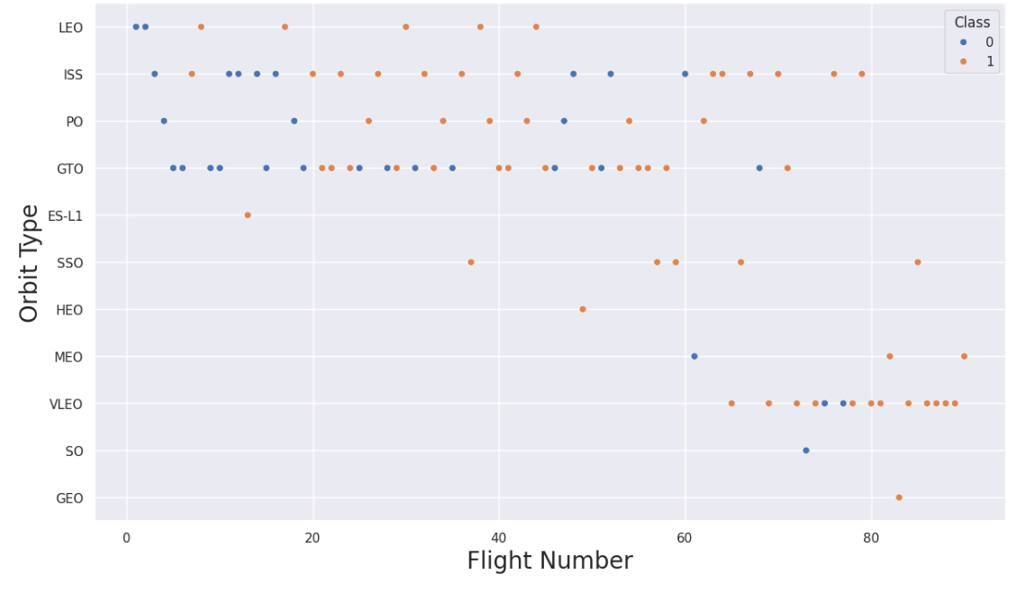
EDA with Data Visualization
I utilized seaborn and matplotlib for the visualization of static charts, plot type such as catplot for displaying the relationship between PayloadMass and LaunchSite, barplot for orbit and class, and a line plot to show the trend of average success rate of rocket launches over time (2010-2020).
GitHub EDA with Visualization
Orbit Type and Flight Number Chart

Slide 12
EDA with SQL
Names of unique launch sites in the space mission
Five records where launch sites begin with string ‘CCA’
Total payload mass by NASA (CRS)
Average payload mass carried by booster version F9 v1.1
First successful landing outcome in ground pad
Success in drone ship, payload mass >4000 but <6000
Total number of successful and failure mission outcomes
Booster_versions with maximum payload mass
Month names of failure landing outcomes in drone ship in year 2015
Landing outcomes counts between “2010-06-04” and 2017-03-20” in descending order
GitHub URL EDA with SQL Notebook

Slide 13
Build an Interactive Map with Folium
In the interactive map with Folium, I added objects such as markers which is used to pin the location of the launches, examples is the NASA JSC space station launch site, circle to highlight the area with a text label on a specific coordinate and line for the proximity of the launch sites.
GitHub URL Launch Site Analysis with Folium

Slide 14
Build a Dashboard with Plotly Dash
In the Plotly Dash user application I have added a dropdown list and a range slider to allow a user to interact with a pie chart and the scatter point chart
Then plotted a scatter graph showing the relationship with Outcome and Payload Mass (Kg) for the different booster version
GitHub URL Plotly Dash

Slide 15
Predictive Analysis (Classification)
Building the Model
Loaded the dataset into NumPy and Pandas
Transformed the data and then split into training and test sets
Decided which type of ML to use
Set the parameters and algorithms to GridSearchCV and fit it to the dataset
Evaluating the Model
Checked the accuracy for each model
Tuned hyperparameters for each type of algorithms
Plotted the confusion matrix
Find the BEST Model
The model with the best accuracy score will be the best performing model
Improving the Model
Used Feature Engineering and Algorithm Tuning
GitHub URL Classification

Slide 16
Results
The findings of the exploratory stage were quite interesting with NASA CRS having a total “payload mass” of 45,596, average payload mass of “booster version F9 v1.1” is 2928.4. First successful landing outcome ground pad was achieved in “2015-12-22” and up to 5 Booster_version having a successful landing outcome on “drone_ship” with a payload mass between 4000 and 6000. A total of 99 successful mission outcomes was also achieved by SpaceX’s Falcon 9.
The visualization also depict some interesting findings, with higher success rate for CCAFS SLC 40 as the flight number increases, and high success rates (100%) of Falcon 9 landing for Orbit type “ES-L1, SSO, HEO, and GEO”. Also there has been tremendous success in Falcon 9’s first stage landing over time since 2010-2020.
I used four different machine learning algorithms the baseline Logistic Regression, Support Vector Machine, Decision Tree classifier and KNN. All the models yield a better performance with a accuracy above 83%, while Decision Tree with GridSearchCV achieved the highest accuracy of 88.89% and F-1 score of 88.21%. Meaning I am confident enough that 88.89% of the time our model will be able to predict whether Falcon 9’s first stage landing will be successful

Slide 17

Section 2

Slide 18
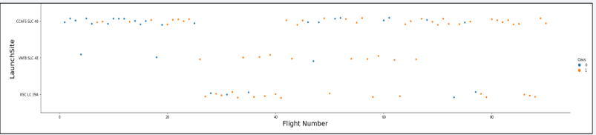
Flight Number vs. Launch Site
As shown above, the relationship between Flight Number and LaunchSite, we can see that with lower flight number (20) there’s no failure or success metric for “KSC LC 39A”, but two failures for the “VAFB SLC 4E”. As the flight numbers increase past 80, there are more successes “CCAFS SLC 40” and none for “VAFB SLC 4E”.

Slide 19
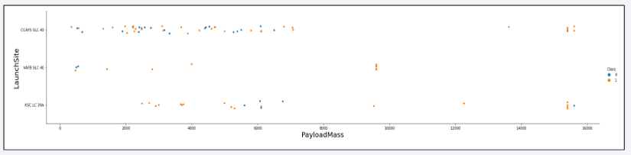
Payload vs. Launch Site
As shown above, the relationship between Flight Number and LaunchSite, we can see that with lower flight number (20) there’s no failure or success metric for “KSC LC 39A”, but two failures for the “VAFB SLC 4E” and more failures than success for “CCAFS SLC 40”. As the flight number increases past 80, there are more success “CCAFS SLC 40” and ore for “VAFB SLC 4E”.

Slide 20
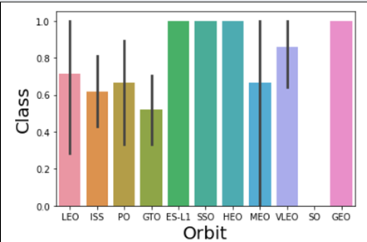
Success Rate vs. Orbit Type
Four Orbit type have the highest success rate of 100% ES-L1, SSO, HEO, and GEO.

Slide 21
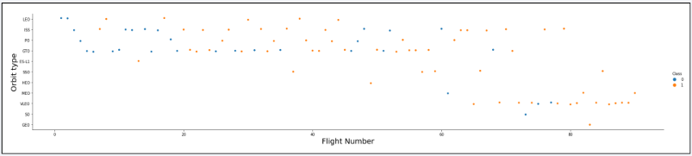
Flight Number vs. Orbit Type
We can see that in the VLEO orbit there seems to be success rate only when the flight number is greater than 60. While there seems to be no relationship in the GTO.

Slide 22
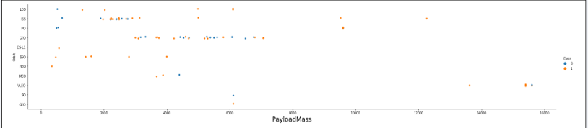
Payload vs. Orbit Type
There is more positive landing rates with heavy payloads for Polar, LEO, and ISS, however for GTO there’s the presence of both positive and negative landings.

Slide 23
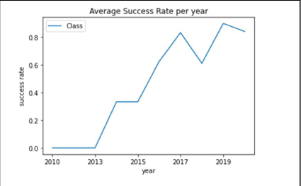
Launch Success Yearly Trend
The yearly success rates of Falcon 9 landing kept increasing since 2013 to 2020.

Slide 24
All Launch Site Names
The Names of unique launch sites are as follows:
CCAFS-LC-40: Space Launch Complex 40 formerly Launch Complex 40 (LC-40) is an orbital launch pad located in northern Cape Canaveral, Florida.
VAFB SLC 4E: Vandenburg AFB Space Launch Complex 4 is a launch and landing site at Vanderburg Space Force Base, California. It has two pads, both of which are used by SpaceX for Falcon 9, one for launch operations and the other as Landing Zone 4 for SpaceX Landings.
KSC LC-39A: Kennedy Space Center Launch Complex 39A is the first of Launch Complex 39’s three launch pads, located at NASA’s Kennedy Space Center in Merritt Island, Florida.

Slide 25
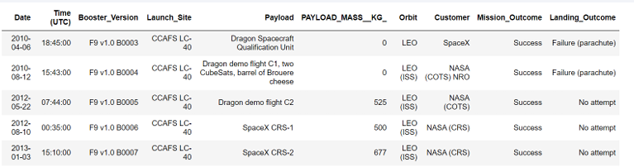
Launch Site Names Begin with 'CCA'
List of the first five Launch Site’s whose names begin with “CCA”

Slide 26
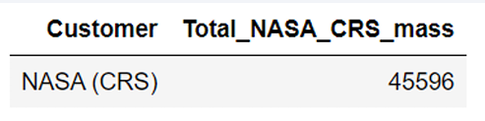
Total Payload Mass
Total Payload mass of boosters from NASA is 45596.

Slide 27
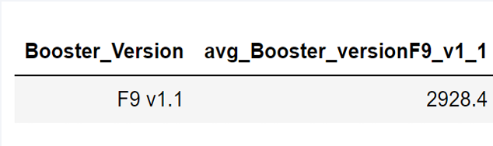
Average Payload Mass by F9 v1.1
The Average Payload Mass carried by booster version F9 v1.1 is 2928.4.

Slide 28
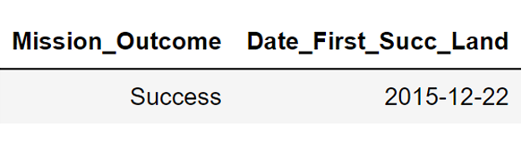
First Successful Ground Landing Date
The date of the first successful landing outcome on ground pad is 2015-12-22

Slide 29
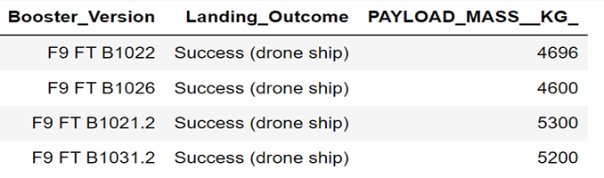
Successful Drone Ship Landing with Payload between 4000 and 6000
The names of boosters which have successfully landed on drone ship and had a payload mass greater than 4000 but less than 6000 are represented in the picture above.

Slide 30
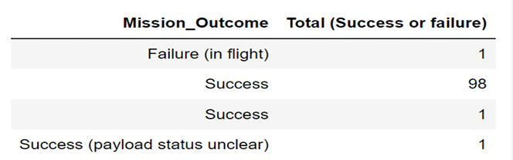
Total Number of Successful and Failure Mission Outcomes
The total number of successful and failure mission outcomes are 98 for success, and one for failure (in flight), and 1 for success (payload status unclear).

Slide 31
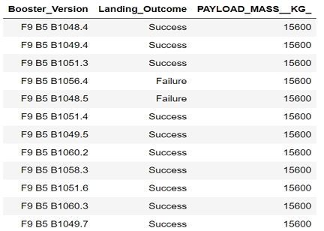
Boosters Carried Maximum Payload
List of the booster which have carried the maximum payload mass

Slide 32
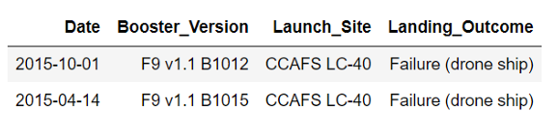
2015 Launch Records
Lis of the failed landing outcomes in drone ship, their booster versions, and launch site names for the year 2015.

Slide 33
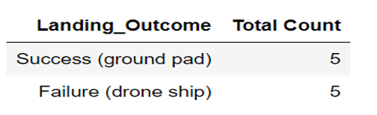
Rank Landing Outcomes Between 2010-06-04 and 2017-03-20
Rank of landing outcomes (such as Failure (drone ship) or Success (ground pad) count between the dates of 2010-06-04 and 2017-03-20, in descending order

Slide 34

Section 3

Slide 35
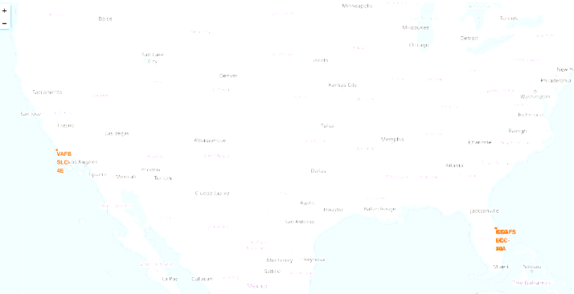
Marked Launch Sites
United States View of Marked Launch Sites

Slide 36
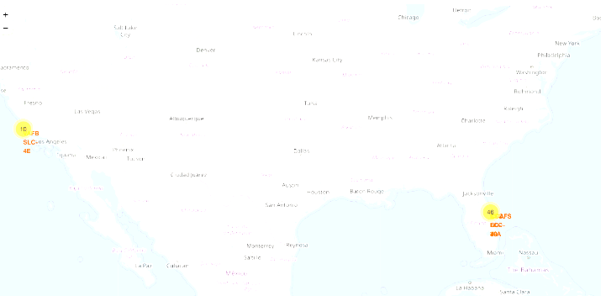
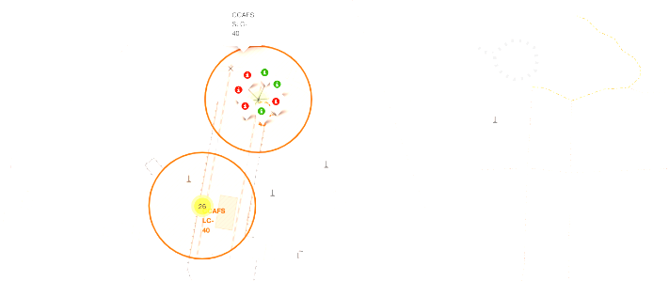
Maps w/ Marker Clusters
Using Color coded and labeled markers I can easily identify which launch sites have relatively high success rates.

Slide 37
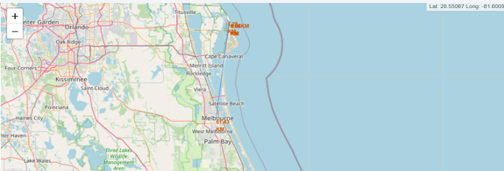
Proximities
Proximities such as railway, highway, coastline with distance calculated and displayed

Slide 38

Section 4

Slide 39
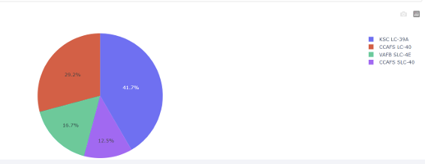
Pie Chart of ALL Launch Sites
KSC LC-39A makes up 41.7% of the pie chart showing it has more launches than the other sites, followed by CCAFS LC-40 with 29.2%

Slide 40
<Dashboard Screenshot 2>
Replace <Dashboard screenshot 2> title with an appropriate title
Show the screenshot of the piechart for the launch site with highest launch success ratio
Explain the important elements and findings on the screenshot

Slide 41
<Dashboard Screenshot 3>
Replace <Dashboard screenshot 3> title with an appropriate title
Show screenshots of Payload vs. Launch Outcome scatter plot for all sites, with different payload selected in the range slider
Explain the important elements and findings on the screenshot, such as which payload range or booster version have the largest success rate, etc.

Slide 42

Section 5

Slide 43
Classification Accuracy
Visualize the built model accuracy for all built classification models, in a bar chart
Find which model has the highest classification accuracy

Slide 44
Confusion Matrix
Show the confusion matrix of the best performing model with an explanation

Slide 45
Conclusions
Point 1
Point 2
Point 3
Point 4
…

Slide 46
Appendix
Include any relevant assets like Python code snippets, SQL queries, charts, Notebook outputs, or data sets that you may have created during this project

Slide 47


